Slide 1
Predicting Cancellations
Understand which items are most significant in causing customers to leave
Cost/benefit analysis to figure out the best way to retain customers

Slide 2
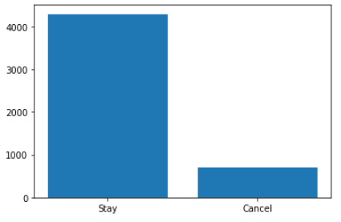
Imbalanced Data
Total Customers: 5,000
Customers Staying: 4,293
Customers Cancelling: 707
4293
707

Slide 3
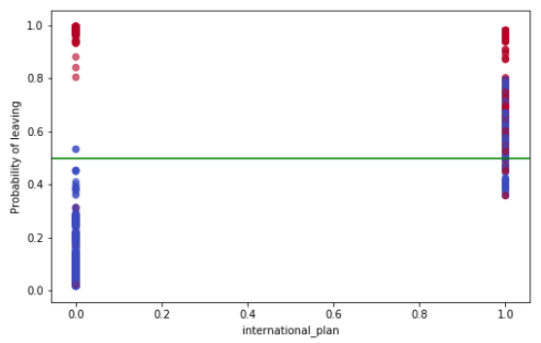
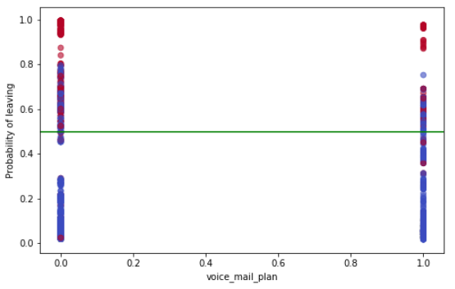
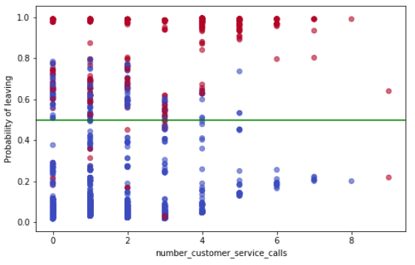
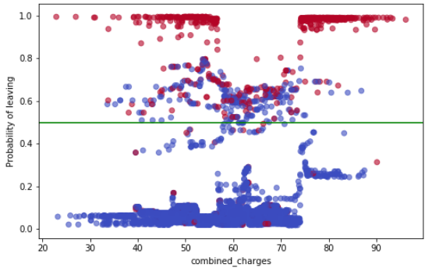
Most significant factors
Blue = Staying
Red = Canceling

Slide 4
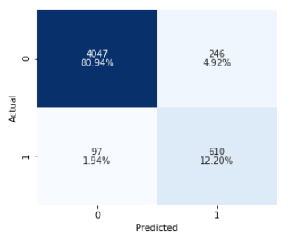
Predictions by the Numbers
4047 Customers correctly classified as staying
610 customers correctly classified as cancelling
246 customers incorrectly classified as leaving
97 customers incorrectly classified as staying

Slide 5
Recommendations
Average bill = $60
24 Month contract brings in $1440
Promotion worth = $500
246 * Promotion: Loss
97 * 24 month contract: Loss
610 * (24 month contract – Promotion): Gain
Cost / Benefit of $310,720
$0
- $500
- $1440
$940

Slide 6
Scenarios
Alex has a bill over $72 a month and is planning to cancel service. Total bill over 24 months - $1738 We offer $500 off a new phone in exchange for a 24 month contract. We gain $1238 over 24 months
Jack has a bill over $72 a month but is not planning to cancel service. Total bill over 24 months - $1738 We offer $500 off a new phone in exchange for a 24 month contract. We lose $500 over 24 months

Slide 7
Further Work
Identify the best promotion amount to retain customers
Identify the best promotions to offer: i.e discounted phone, discount on plan etc.

Slide 8
Thank you very much for joining me! ☺ Levi Raichik

